Slide 1
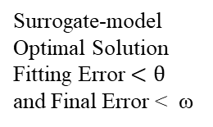
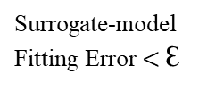
Start
Build Numerical Simulation
Preprocess Data
Build Surrogate-model
no
Surrogate-model
Fitting Error $<$Ɛ
yes
Add Optimal Solution
Minimize Predicted Error
no
Surrogate-model
Optimal Solution
Fitting Error $<θ$
and Final Error < ω
yes
Stop

Slide 2
Start
Initialize population P(t)
Set fitness function and evaluate P(t)
Encode chromosome
Apply reproduction and crossover on P(t) to yield C(t)
no
Apply mutation on C(t) to yield D(t)
and then evaluate D(t)
Select P(t), C(t), and D(t)
based on the fitness function
Reach maximum iteration
Stop

Slide 3
Start
Generate the initial condition of each particle
Evaluate the fitness of each particle
no
Update the position of the particles
yes
Reach stopping criteria
Stop

